Slide 1

Hands on with Hadoop
Naren Thilla
With Contributions from: Manas Mohapatra
Feb 26th 2014
Part 4a – Data Ingestion Techniques

Slide 2
Data Ingestion Techniques
Batch/ETL Based Data Ingestion:
Data Ingestion Using Sqoop
Data Ingestion Using Talend
Custom Code
Real Time Data Ingestion:
Using Flume
Using Spark Streaming
Using KAFKA

Slide 3
Part 4a – Data Ingestion using Sqoop

Slide 4

Agenda
Sqoop Introduction & Motivation
Sqoop 1 vs. Sqoop 2
Sqoop Architecture
Sqoop Hand-on Exercises
Ex 0: Pre-req (MySQL Setup and Sample Data load)
Importing csv data into HDFS
Ex1: Importing Mysql Data into HDFS
Ex 2: Setting up the Cookbook data
Ex 3: Loading partial data.
Ex 4: File Formats (Avro, SequenceFiles), Accumulo & Compression
Ex 5: Custom Data Types
Ex 6:Controlling Parallelism
Ex 7: Initial Load (Full Import)
Ex 8: Incremental Load
Ex 9: Importing Data into Hive
Ex 10: Leveraging Hive Partitions
Ex 11: Exporting Data
Ex 12: Scheduling Data Loads

Slide 5
Sqoop Introduction
A bulk-data transfer tool that helps in transfer of data between RDBMS and Hadoop
Has support for popular Databases such as Oracle, MySQL, SQL Server, PostGres etc
Leverages Hadoop’s MR jobs

Slide 6
Pre-Req: Setting up MySQL
Step 0: Remove previous installs if any
sudo apt-get remove --purge mysql-server mysql-client mysql-common
Step-1:- SSH into instance-4 and sudo su – (Note: You can choose any node other than instance-1 to sufficient balance the load/role across the clusters).
mkdir /opt/downloads
sudo apt-get install mysql-server
It will ask for password type two times root
Step-2:- Once the installation is complete, the MySQL server should be started automatically.
To check : sudo netstat -tap | grep mysql
step-3:-if the server is not running then type command: sudo service mysql restart
step-4a (optional) :-configuration changes. As root user (sudo su -), open the file /etc/mysql/my.cnf to configure the settings.
. For example, to configure MySQL to listen for connections from network hosts, change the bind-address directive to the server's IP address or default IP “0.0.0.0”:
bind-address = 0.0.0.0
step-4b: after making bind address change.mysql need to be restarted: sudo service mysql restart
Step-5 (optional): If you would like to change the MySQL root password, in a terminal enter:
sudo dpkg-reconfigure mysql-server-5.5

Slide 7
Pre-Req: Installing MySQL (Source System)
Step 6: copy the Mysql Driver Jar file
FTP the mysql-connector-java-5.1.35-bin.jar file from z:/datamanagement-dev/…/code/external jars
cp <mysql-connector-java-5.1.35-bin.jar> /opt/cloudera/parcels/CDH/lib/sqoop/
<Alternatively you can wget the same from http://dev.mysql.com/get/Downloads/Connector-J/mysql-connector-java-5.1.35.tar.gz>
wget http://dev.mysql.com/get/Downloads/Connector-J/mysql-connector-java-5.1.35.tar.gz
apt-get install unzip
tar -xvf *.tar
cp mysql-connector-java-5.1.35-bin.jar /usr/lib/sqoop/lib
cp mysql-connector-java-5.1.35-bin.jar /opt/cloudera/parcels/CDH/lib/sqoop/
Step 7: chmod /user in HDFS: $hadoop fs -chmod 777 /user

Slide 8
Pre-req: Setting up DB
Step-7:- Start mysql
% mysql -u root –p (root/root is the username/password)
Step-8:- create database with any name(ex:manas)
% mysql> create database test;
step-9:- then grant all the PRIVILEGEs to local user
% mysql> GRANT ALL PRIVILEGES ON test.* TO '%'@'localhost';
% mysql> GRANT ALL PRIVILEGES ON test.* TO ''@'localhost';
Step-10: Create a table
CREATE TABLE widgets(id INT NOT NULL PRIMARY KEY AUTO_INCREMENT,
widget_name VARCHAR(64) NOT NULL,
price DECIMAL(10,2),
design_date DATE,
version INT,
design_comment VARCHAR(100));
Step 11: Insert sample data
INSERT INTO widgets VALUES (NULL, 'sprocket', 0.25, '2010-02-10',1, 'Connects two gizmos');
INSERT INTO widgets VALUES (NULL, 'gizmo', 4.00, '2009-11-30', 4, NULL);
INSERT INTO widgets VALUES (NULL, 'gadget', 99.99, '1983-08-13', 13, 'Our flagship product');
Ex 0: z:/datamanagement-dev …/code/sqoop/sqoop-db-setup.txt

Slide 9
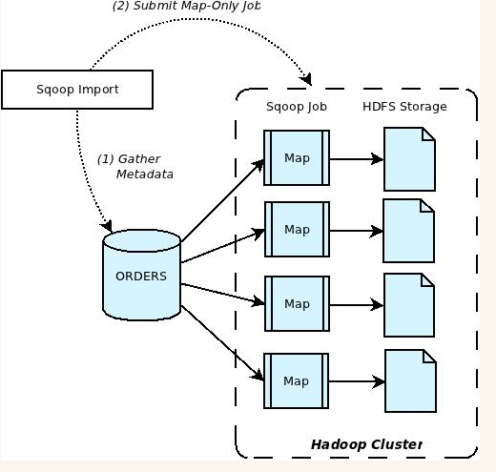
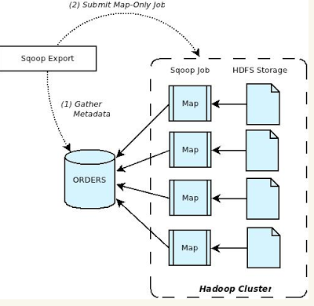
Sqoop Architecture
Other Data Ingestion Techniques
Talend Big Data
Point solutions:
http://www.syncsort.com/en/Solutions/Hadoop-Solutions/Data-Warehouse-Offload-to-Hadoop

Slide 10
Importing .csv data into HDFS
LOAD DATA [LOCAL] INPATH 'filepath' [OVERWRITE] INTO TABLE tablename [PARTITION (partcol1=val1, partcol2=val2 ...)]
Load data from hdfs to Hive Metastore:
Load Data inpath /user/cloudera/employees into table employees
Load data from local unix folder to Hive Metastore:
Load Data local inpath /tmp/employees into table employees
Note these are not sqoop commands, but rather hive commands.

Slide 11
Ex1: Importing Mysql Data into HDFS
Sudo – hdfs
$ sqoop import --connect "jdbc:mysql://<hostname>:3306/test"
--username root
--password root
--table widgets
--target-dir hdfs:/user/cloudera/widgets/
#=== Hostname = MySQL IP address or DNS name. Add your hostname here.
#=== 3306 is the default MySQL Port.
#==== test is the database created in the earlier steps
#=== HDFS target directory is /user/cloudera/widgets
Note: The data will be stored in a flat file and NOT in a database. Check if there is a corresponding
Ex 1: z:/datamanagement-dev …/code/sqoop/sqoop-load-to-hdfs.txt

Slide 12
Ex 2: Setting up the Cookbook data
For the rest of the examples, we will be using the Sqoop cookbook examples. So, setting up the environment is essential.
https://github.com/jarcec/Apache-Sqoop-Cookbook
You can find following files in this repository
mysql.credentials.sql Script that will create necessary user account and database on MySQL server.
mysql.tables.sql Script that will create and populate example data for MySQL so that you can easily run all examples in the book.
These scripts are also downloaded at z:/…./code/sqoop/sqoop-cookbook
Copy the scripts and run them in Mysql client window
Ex 2: z:/datamanagement-dev …/code/sqoop/sqoop-cookbook-setup.sh

Slide 13
Ex 3: Loading partial data.
You can load partial/filtered data from the source using Sqoop using the where clause.
sqoop import \
--connect jdbc:mysql://localhost:3306/sqoop \
--username sqoop \
--password sqoop \
--table cities \
--where "country = 'USA'"
# Here, the column city has been dropped
sqoop import \
--connect jdbc:mysql://localhost:3306/sqoop \
--username sqoop \
--password sqoop \
--query 'select id, country from cities where $CONDITIONS' \
--target-dir /user/hive/warehouse \
--split-by id
Ex 3: z:/datamanagement-dev …/code/sqoop/ sqoop-partial-dataload.sh

Slide 14
Ex 4: File Formats (Avro, SequenceFiles), Accumulo & Compression

Slide 15
Ex 5: Bulk Loading – Direct Option
Use the –direct switch to speed up bulk imports
This option uses native utilities and does not process via JDBC.
Not all parameters are available for this option
sqoop import --connect "jdbc:mysql://localhost:3306/test" --username root --password root --direct --table widgets --target-dir hdfs:/user/cloudera/widgets2/
Ex 5: z:/datamanagement-dev …/code/sqoop/ sqoop-load-to-hdfs-direct.sh

Slide 16
Ex 5: Custom Data Types

Slide 17
Ex 6:Controlling Parallelism
sqoop import \
--connect jdbc:mysql://mysql.example.com/sqoop \
--username sqoop \
--password sqoop \
--table cities \
--num-mappers 10
Default is 4.
If the data set is small, Sqoop automatically reverts back to the optimal number.
Do not increase the num-mappers arbitrarily. Very high numbers can setback the performance of the source system.
Ex 6: z:/datamanagement-dev …/code/sqoop/ sqoop-parallelism.sh

Slide 18
Ex 7: Initial Load (Full Import)
sqoop import-all-tables \
--connect jdbc:mysql://localhost:3306/sqoop \
--username sqoop \
--password sqoop \
--exclude-tables cities, countries
Ex 6: z:/datamanagement-dev …/code/sqoop/ sqoop-initial-load.sh

Slide 19
Ex 8.1: Changed Data Load – Truncate & Load
The default behavior while loading is to append the data to the existing table.
Use ----hive-overwrite to do truncate & load
Beware, this may not work well for large tables.
sqoop import \
--connect jdbc:mysql://localhost:3306/sqoop \
--username sqoop \
--password sqoop \
--table cities \
--hive-overwrite \
--hive-import \
--warehouse-dir /user/hive/warehouse
Ex 8: z:/datamanagement-dev …/code/sqoop/ sqoop-trunc-load.sh

Slide 20
Ex 8.2: Changed Data Load – Incremental Load
http://hortonworks.com/blog/four-step-strategy-incremental-updates-hive/
TBD

Slide 21
Ex 9: Importing Data into Hive
sqoop import \
--connect jdbc:mysql://localhost:3306/sqoop \
--username sqoop \
--password sqoop \
--table cities \
--hive-import
-- warehouse-dir /user/hive/warehouse # optional
You can also override the default data type mappings by using the following syntax:
sqoop import \
...
--hive-import \
--map-column-hive id=STRING,price=DECIMAL
Ex 9: z:/datamanagement-dev …/code/sqoop/ sqoop-hive-load.sh

Slide 22
Ex 10: Leveraging Hive Partitions
You can partition data sets while loading into Hive.
The partitioned data set can be loaded into Hive partitions
Ex 10: z:/datamanagement-dev …/code/sqoop/ sqoop-hive-load-partitioned-tables.sh

Slide 23
Ex 11: Exporting Data
Exporting from Hadoop into RDBMS is possible using the export key word.
Use the –staging table operator to ensure “atomicity” while exporting
The staging table should have been created prior to the sqoop export
sqoop export \
--connect jdbc:mysql://mysql.example.com/sqoop \
--username sqoop \
--password sqoop \
--table cities \
--staging-table staging_cities
Ex 11: z:/datamanagement-dev …/code/sqoop/ sqoop-export-data.sh

Slide 24
Ex 12: Scheduling Data Loads

Slide 25
Part 4a – Data Ingestion using Talend

Slide 26
Data Ingestion using Talend
TBD

